Slide 1
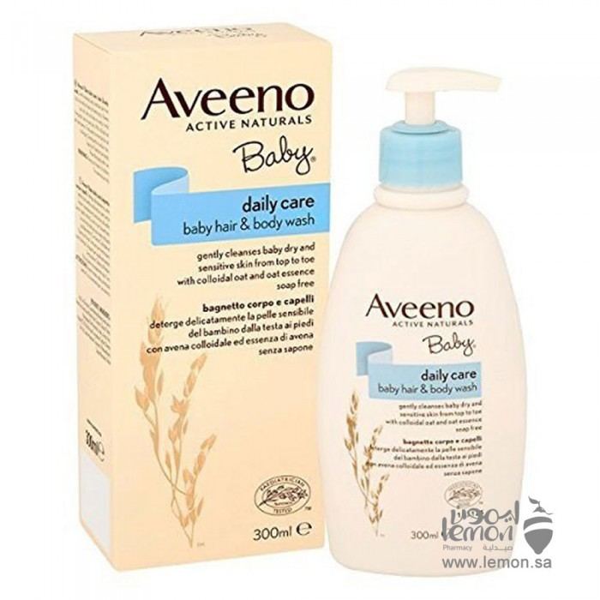
Avino Baby Skin & Hair Cleansing Wash 300ml
74.52 R.S
How to use: apply a small amount in your hand, massage the hair and body, then rinse gently. Keep out of reach of children and keep out of the sun

Slide 2
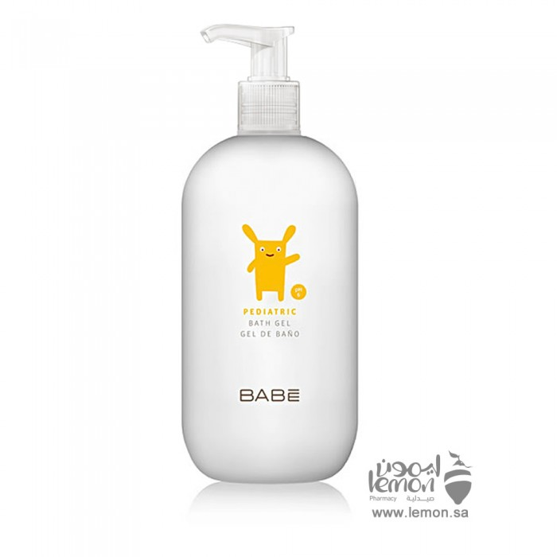
PapiBabi Baby Shower Gel & Lotion no eye irritation 500 ml
107.53 R.S
Babi baby shower gel gently cleanses baby's skin and does not cause irritation or skin sensitivity can be used for children from the first day leaves baby's skin moist and fresh after each shower and does not irritate the eyes. Babycare sulfate-free gentle shower gel is used for infants and toddlers and contains vitamin babycare complex, which ensures effective hydration during bathing. This product can be used as a shower gel or lotion and is also excellent when used as a baby hand wash.

Slide 3
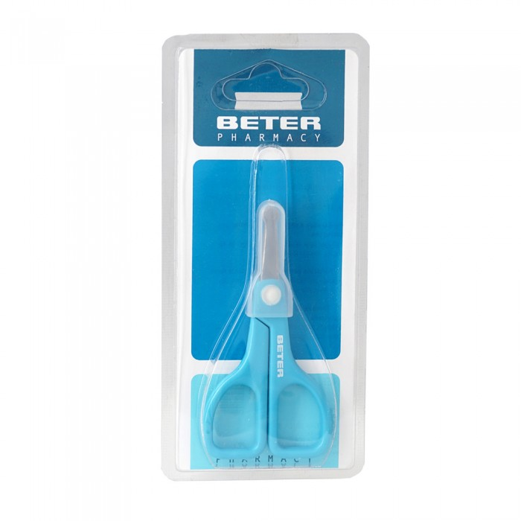
Peter scissorsManicure scissors baby Peter plastic handle 9.2 CM
32.86 R.S
Peter's baby scissors made of steel are soft on children's skin and do not cause pain when cutting

Slide 4
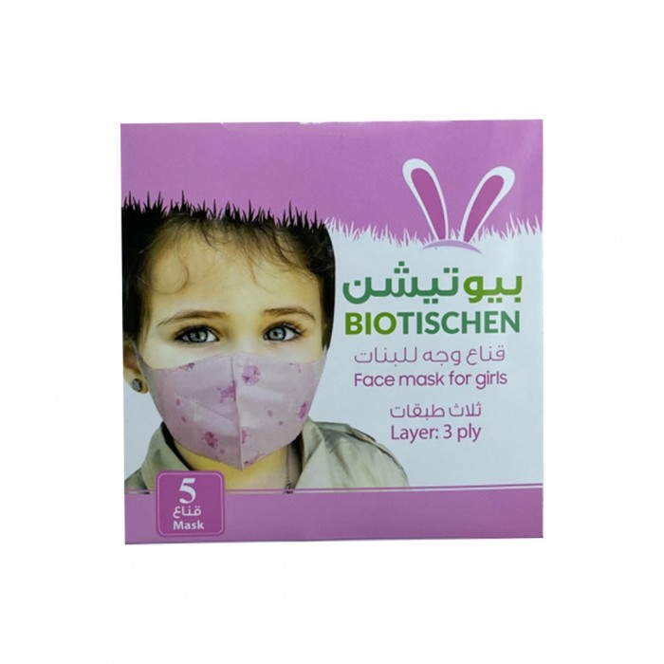
Biotechin Beauty Face masks for girls 3 layers
5 items
5.00 R.S
Product Characteristics:- Consists of three layers in - - - - -: 3 - - - - - -.- Non-irritating rubber cloth sealing ring for ear.- Flexible and firm on mouth and nose.- Allows easy breathing which makes it very suitable for children in play places and gatherings.- Pack containing 5 masks

Slide 5
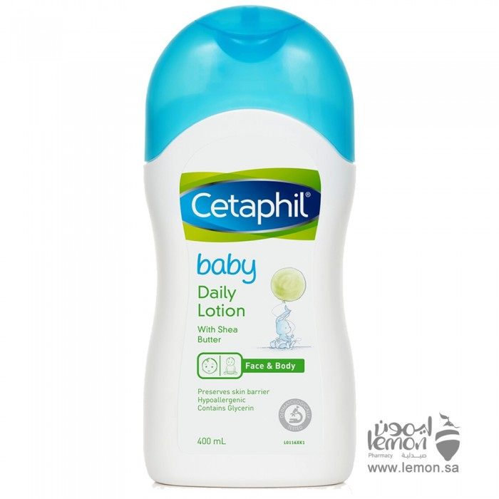
Cetaphil Cetaphil baby moisturizing lotion 400 ml
86.25 R.S
Characteristics:With sweet almond oil and sunflower oil to soften the skinContains organic calendula extract that acts as a skin soothingFree of parabens, colourants and mineral oils

